Slide 1

DSA0404 - FUNDAMENTALS OF DATA SCIENCE
Student Performance Analysis Using Exploratory Data Analysis
GUIDED BY:
PRESENTED BY:
Dr . Krishnaraj Mony
G . Mohammad Taher (192524366)
S . Siva Charan (192472147)
Sravan Kumar Y(192472289)

Slide 2
Introduction
Student academic performance is influenced by factors such as attendance, assignment scores, internal marks, previous marks, and study hours.
The Student Performance Analyser uses data science techniques to analyse academic records and identify important performance patterns and trends.
Data preprocessing and Exploratory Data Analysis (EDA) are used to clean the data and understand relationships between different academic factors.
Machine learning techniques are applied to predict students' final performance based on their academic and related attributes.
The system provides an interactive dashboard and performance insights to help faculty identify students who may need additional support and make timely, data-driven academic decisions.

Slide 3
Problem Statement
Traditional student performance evaluation is often manual and time-consuming, making continuous academic monitoring difficult.
Academic data such as marks, attendance, assignments, and previous performance may be stored in different formats, making analysis difficult.
It is challenging to identify the key factors that influence student academic performance from large datasets.
Faculty may face difficulty in predicting future student performance and identifying students who are likely to underperform.
Lack of clear visual dashboards and performance trends makes it difficult to interpret academic data and compare student outcomes.
There is a need for a data-driven system that provides timely insights, predicts performance, identifies at-risk students, and supports effective academic decision-making.

Slide 4
Objectives
To collect and preprocess student academic data, including marks, attendance, assignment scores, study hours, and previous academic performance.
To explore and analyse academic data using statistical and Exploratory Data Analysis (EDA) techniques to identify important performance patterns and trends.
To develop a machine learning model for predicting students' final academic performance based on relevant academic factors.
To visualize and present student performance through interactive charts, dashboards, and individual performance reports for easy interpretation.
To identify students at risk of poor performance and provide meaningful insights that can help faculty offer timely academic guidance and support.

Slide 5
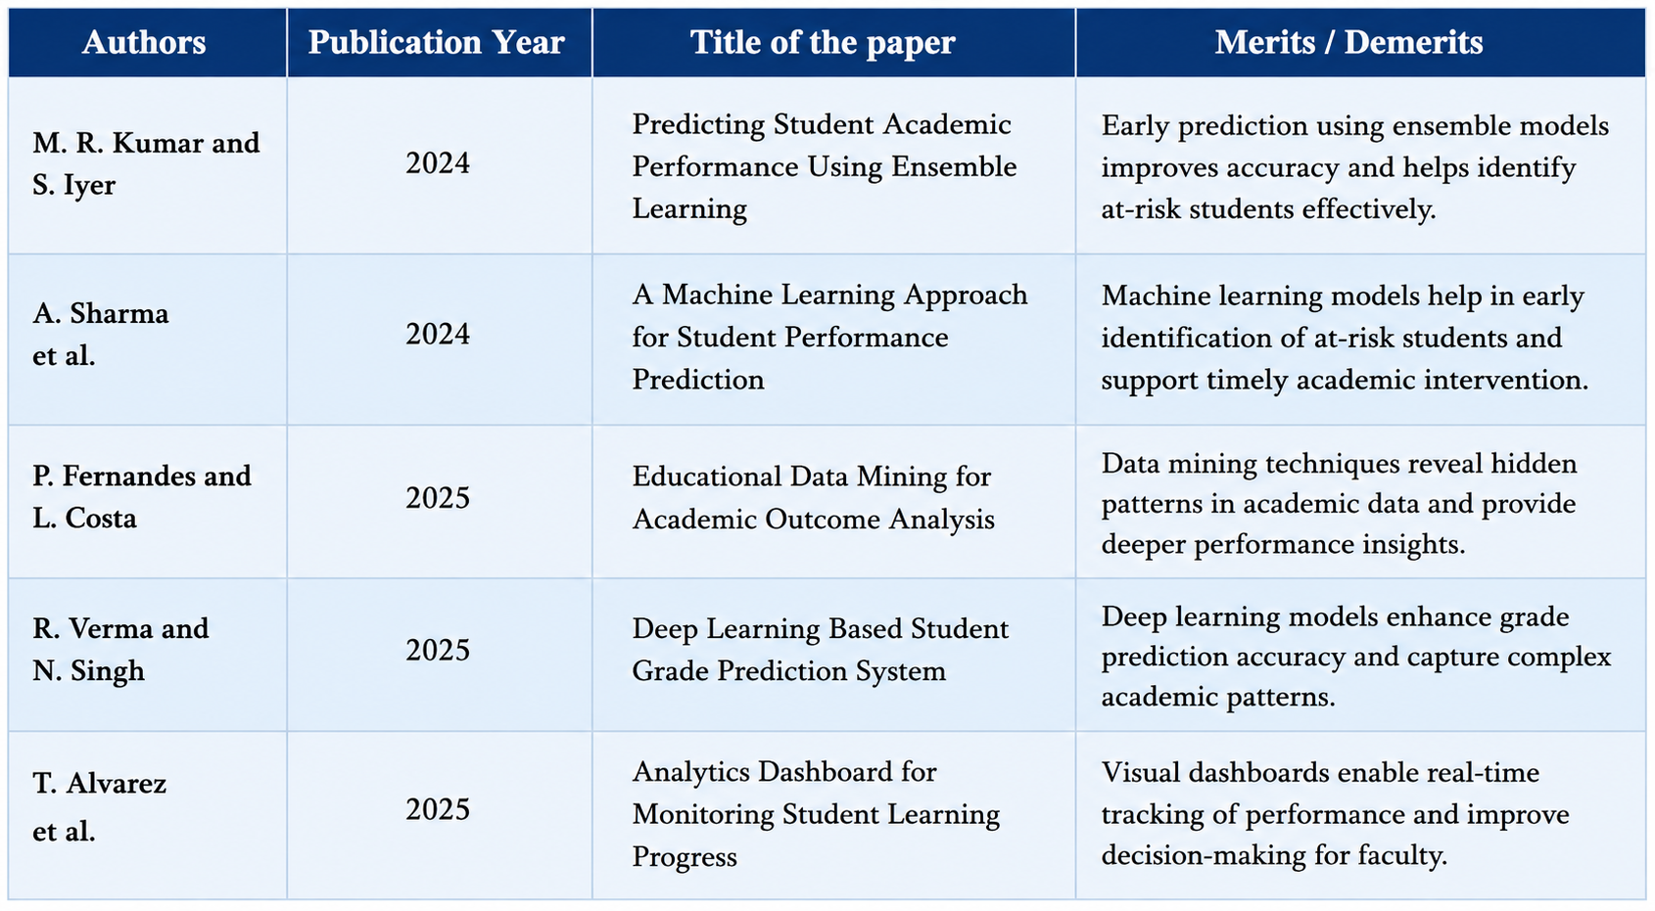
Literature Review

Slide 6
Algorithm
Input: Load student academic dataset containing marks, attendance, assignments, study hours, and previous performance.
Preprocess Data: Handle missing values, remove duplicates, encode categorical data, and normalize numerical features.
Perform EDA: Calculate statistical measures and analyse relationships between academic factors and student performance.
Feature Selection: Select relevant features affecting the final performance.
Model Training: Split the dataset into training and testing sets and train Regression, Decision Tree, and Random Forest models.
Model Evaluation: Generate predictions and evaluate the models using appropriate performance metrics; select the best-performing model.
Performance Prediction: Use the selected model to predict the student's final score.
Performance Classification: Categorize students as High, Average, or At-Risk based on the predicted performance.
Visualization: Display performance statistics, trends, predictions, and at-risk students through an interactive dashboard.
Output: Provide academic insights to support timely faculty guidance.

Slide 7
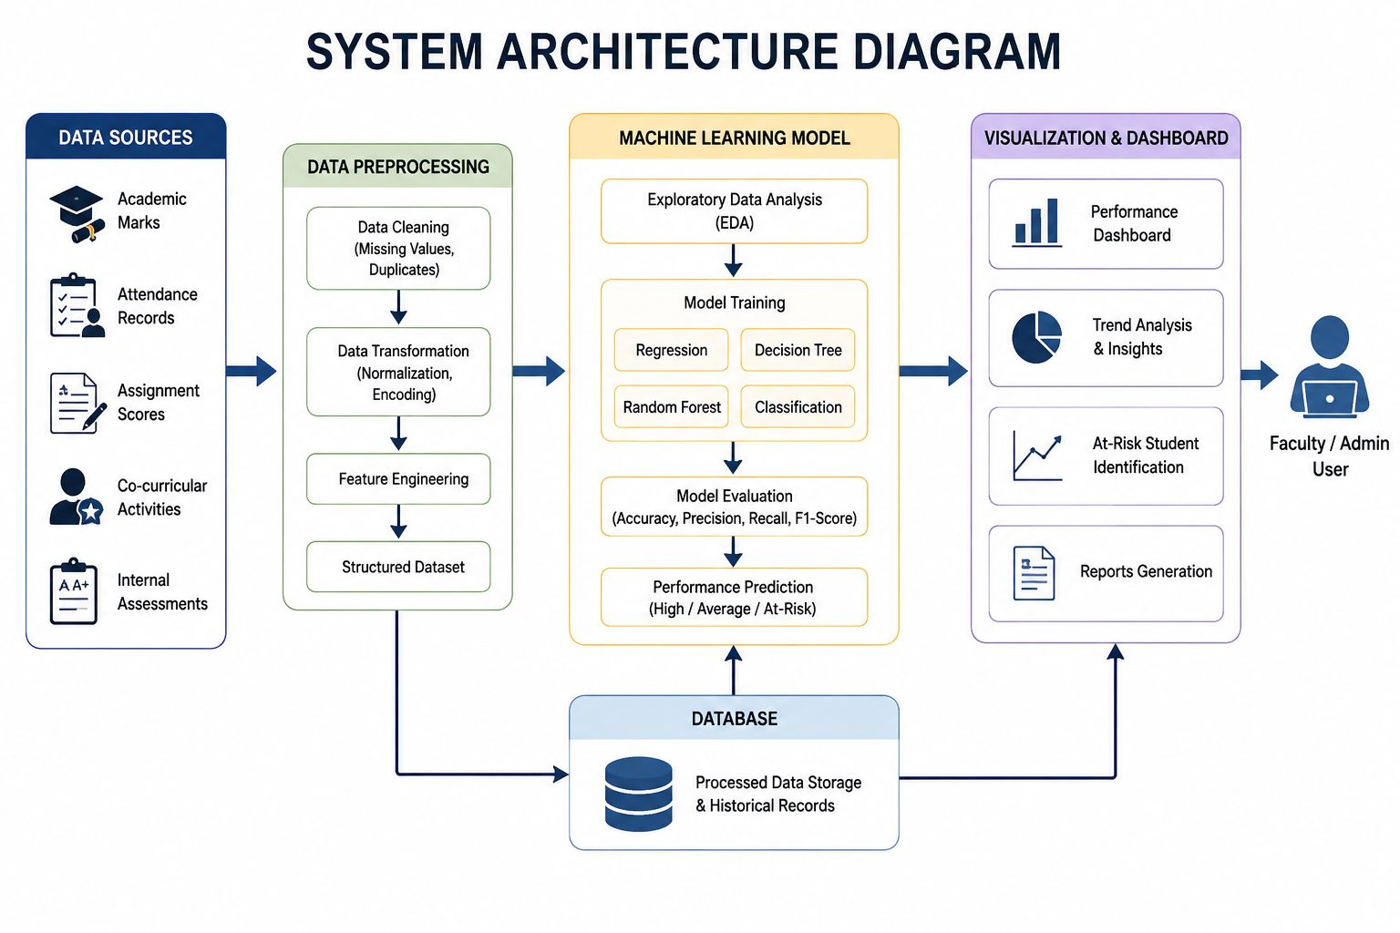

Slide 8
MODULE 1 -Data Collection & Preprocessing
Collect student academic data including attendance, assignment scores, test marks, previous marks, study hours, and final performance.
Load and integrate data from structured sources such as CSV/Excel files into a single dataset.
Inspect data quality by identifying missing values, duplicate records, inconsistent formats, and invalid entries.
Clean and transform the dataset by handling missing values, removing duplicates, correcting data types, and standardizing numerical values.
Encode categorical attributes such as gender and department into a suitable numerical representation for analysis.
Analyse the cleaned data using basic statistical measures to understand student performance patterns.
Select relevant features that contribute to predicting student academic performance.
Generate the final preprocessed dataset and pass it to Module 2 – Performance Prediction using Machine Learning.

Slide 9
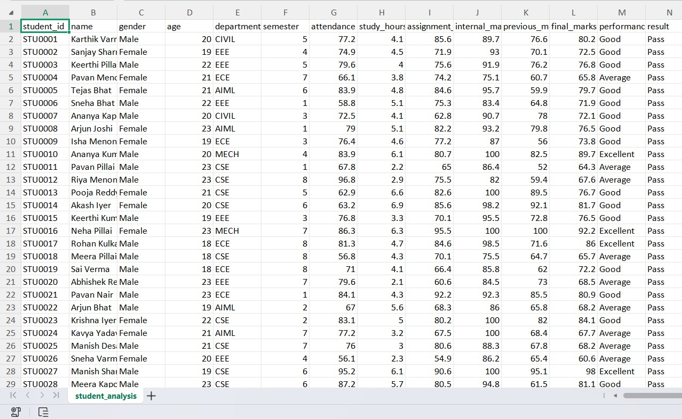
Output Screenshot

Slide 10
MODULE 2 - Performance Prediction using Machine Learning
Prepare the selected features such as attendance, assignment scores, test marks, study hours, and previous academic performance as model inputs.
Split the preprocessed dataset into training and testing sets for reliable model development and evaluation.
Train machine learning model Random Forest to predict students' final performance.
Generate predicted performance scores for the test data and compare them with the actual final scores.
Evaluate and compare the models using suitable metrics such as MAE, RMSE, and R² score to identify the best-performing model.
Use the selected model to predict the final performance of new students.
Categorize predicted performance into High, Average, and At-Risk levels based on predefined performance thresholds.

Slide 11
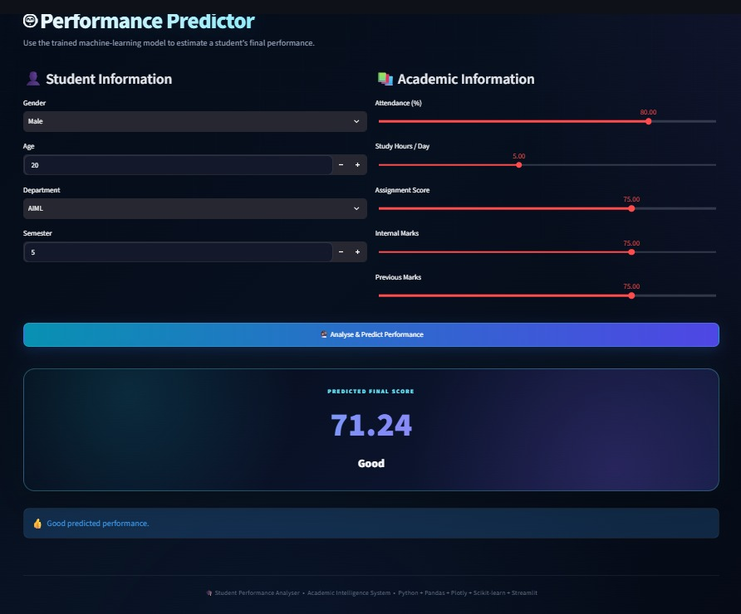
Output Screenshot

Slide 12
MODULE 3 - Visualization & InsightDashboard
Display key performance indicators (KPIs) such as average marks, pass rate, attendance, and number of at-risk students.
Visualize performance distributions using charts to show High, Average, and At-Risk students.
Compare academic performance across subjects, departments, and semesters.
Provide student-wise performance analysis including marks, attendance, assignments, and predicted performance.
Identify and highlight at-risk students based on their performance and prediction results.
Generate actionable insights and summary reports to help faculty understand overall class performance and make informed academic decisions.

Slide 13
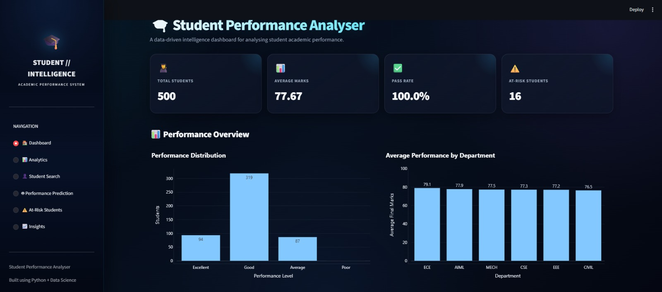
Output Screenshot

Slide 14
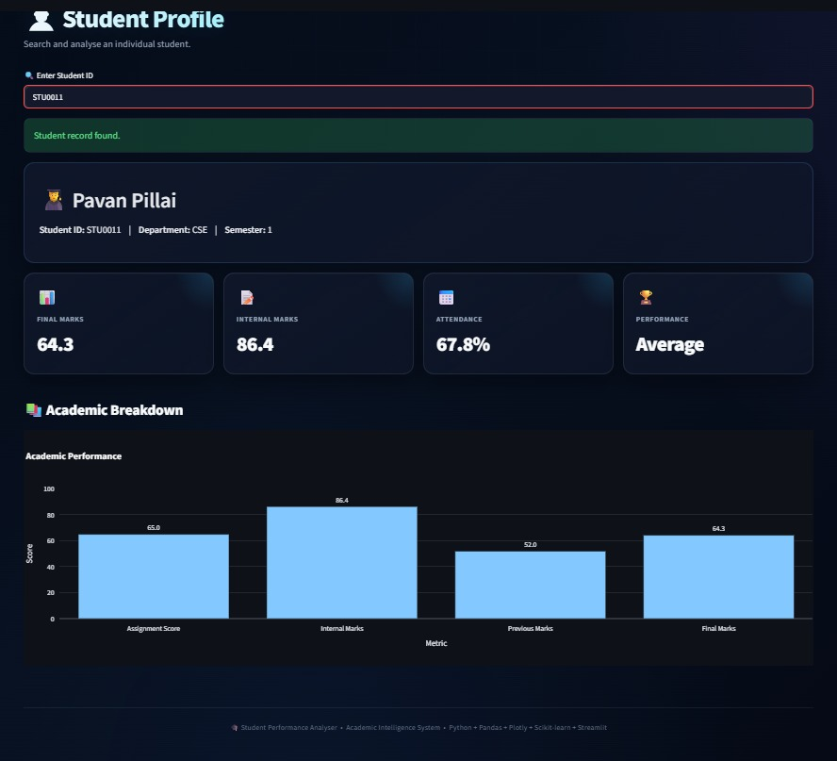
Output Screenshot

Slide 15
Result
Accurate assessment of student academic performance using marks, attendance, assignments, and previous academic records.
Early identification of at-risk students through performance analysis and predicted outcomes.
Reliable performance prediction using Regression, Decision Tree, and Random Forest models.
Interactive visualization of student performance trends, comparisons, and key academic indicators through charts and dashboards.
Actionable academic insights that help faculty provide timely and personalized guidance to students.
Improved academic decision-making by providing faculty with summarized performance reports and data-driven insights for effective student monitoring.

Slide 16
Conclusion
The proposed Student Performance Analyser provides a systematic and data-driven approach to analysing student academic performance.
The system uses data preprocessing, Exploratory Data Analysis, and machine learning techniques to identify important factors influencing student outcomes.
Machine learning models such as Regression, Decision Tree, and Random Forest enable effective prediction of student performance.
The interactive dashboard presents overall, subject-wise, and student-wise performance through clear charts, statistics, and visual reports.
The system helps in early identification of at-risk students, enabling faculty to take timely academic support measures.
Overall, the proposed system improves performance monitoring, data-driven decision-making, and personalized academic guidance compared with traditional manual evaluation.

Slide 17
Future Scope
Real-time data integration can be introduced to automatically update student performance whenever new academic records are added.
Advanced machine learning and deep learning models can be implemented to improve prediction accuracy.
Personalized recommendations can be provided to students based on their performance, strengths, weaknesses, and learning patterns.
Student progress tracking can be extended to monitor performance over multiple semesters and identify long-term academic trends.
Early-warning notifications can be added to alert faculty when a student's performance shows signs of decline.
Mobile and cloud-based deployment can make the system accessible to faculty and students from anywhere.
Advanced analytics and explainable AI can be incorporated to identify why a student is predicted to be at risk and support better academic decision-making.

Slide 18
References
Y. Lou and K. F. Colvin, “Performance Prediction Using Educational Data Mining Techniques: A Comparative Study,” Discover Education, vol. 4, article 112, 2025.
“Prediction of Student Performance in E-Learning Environment Using Machine Learning Techniques,” Procedia Computer Science, vol. 259, pp. 1416–1425, 2025.
“The Integration of Explainable AI in Educational Data Mining for Student Academic Performance Prediction and Support System,” Telematics and Informatics Reports, vol. 18, article 100203, 2025.
“Predictive Analytics in Education – Enhancing Student Achievement Through Machine Learning,” Social Sciences & Humanities Open, vol. 12, article 101824, 2025.
Y. Lou and K. F. Colvin, “Performance Prediction Using Educational Data Mining Techniques: A Comparative Study,” Discover Education, 2025. — Particularly relevant to your use of regression, decision tree, and random forest models.
“Predicting Student Performance: A Comprehensive Review of Machine Learning, Deep Learning, and Explainable AI Approaches,” Computers and Education: Artificial Intelligence, vol. 10, article 100548, 2026.

Slide 19


